Slide 1
Randomized Algorithms CS648
Lecture 15
Delay sequences

Slide 2

Theme of today’s lecture

Slide 3
Distributed Algorithms

Slide 4
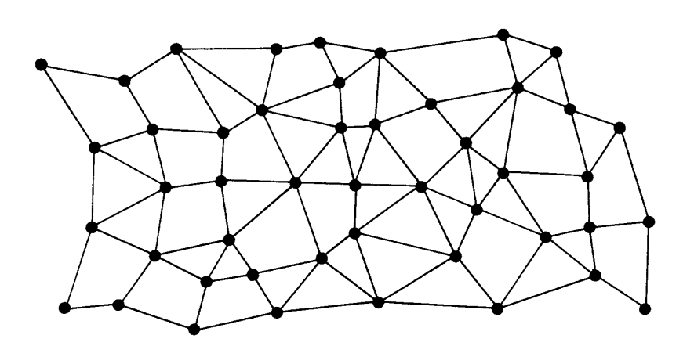




Each node has a processor, a small RAM, and a unique identifier.
Each processor can only interact with its neighboring processors.
$$u$$
$$u$$
Network of processors

Slide 5

Round
Send messages to neighbours
Receive messages from neighbours
Do local computation
$$u$$

Slide 6



Round
$i$th round
$$u$$
$$v$$

Slide 7
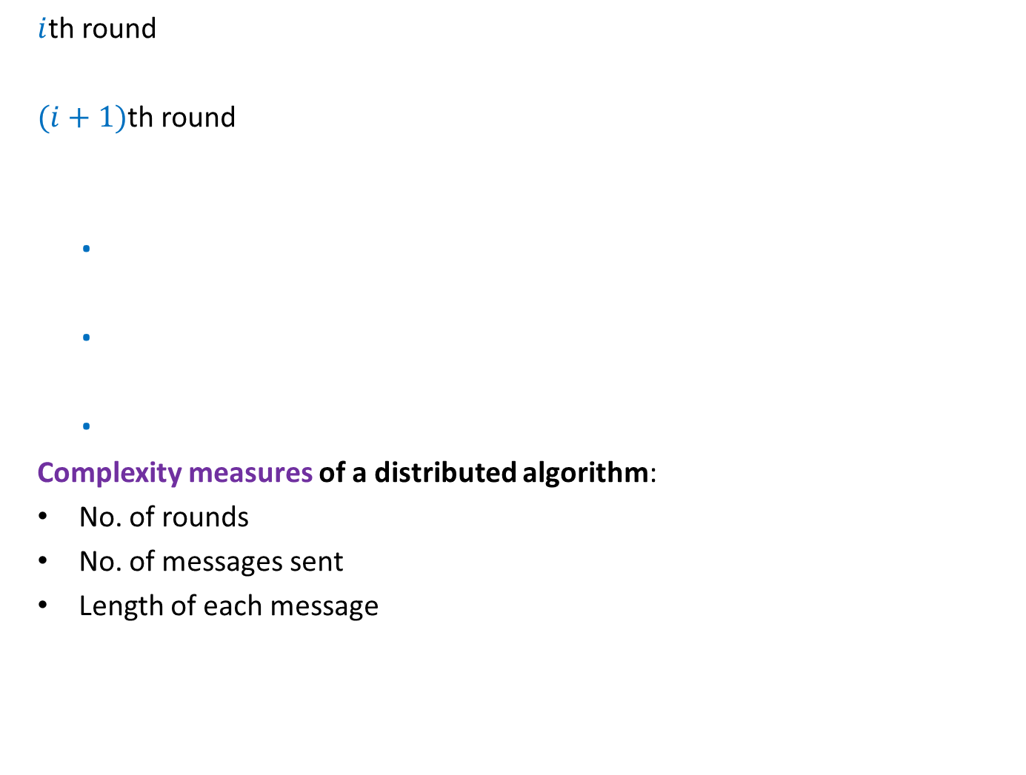
Round
$i$th round
$(i+1)$th round
.
.
.
Complexity measures of a distributed algorithm:
No. of rounds
No. of messages sent
Length of each message
$$u$$
$$v$$
With these features and constraints, it will be interesting to ponder over distributed algorithm for the following problems:
BFS tree (easy)
Maximal Matching (easy)
MST
Maximum Matching

Slide 8

Finding the smallest value
$d$: diameter of the network.
$d$rounds are sufficient.
$$u$$
$$u$$
Network of processors

Slide 9

Finding the Minimum Spanning Tree
$d$: diameter of the network.
$d log n$ rounds are sufficient.
$$u$$
$$u$$
Network of processors

Slide 10




Faulty network
$i$th round
$$i+1$$
$$i$$
$$i$$
$$u$$
$$v$$

Slide 11
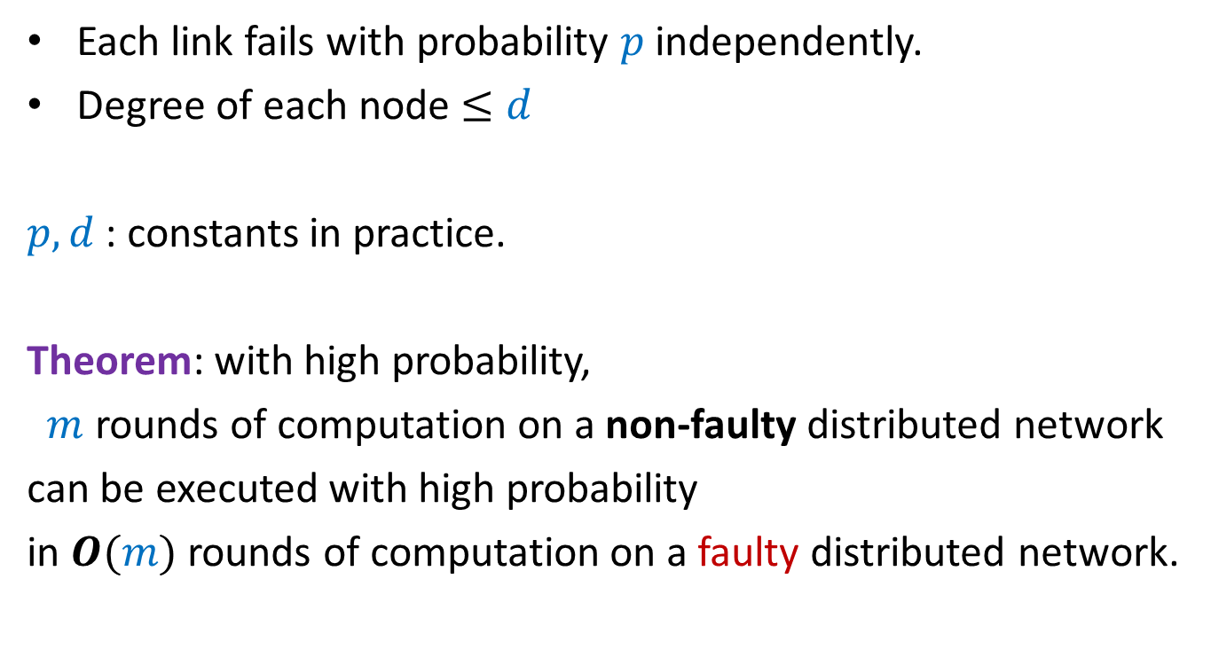
Faulty network
Each link fails with probability $p$ independently.
Degree of each node $≤d$
$p,d$ : constants in practice.
Theorem: with high probability,
$m$ rounds of computation on a non-faulty distributed network
can be executed with high probability
in $O(m)$ rounds of computation on a faulty distributed network.
The proof is based on
“delay sequences” : a tool derived using elementary probability.

Slide 12
We introduce it using An interesting and inspiring Problem
Delay sequences

Slide 13







$n$ Counters
Each counter has a fair coin of its own.
0 0 0 0 0 0
$$1$$
$$2$$
$$i−1$$
$$i$$
$$i+1$$
$$n$$
H
T
T
H
T
T

Slide 14
$n$ Counters
Each counter has a fair coin of its own.
1 0 0 1 0 0
$$1$$
$$2$$
$$i−1$$
$$i$$
$$i+1$$
$$n$$
H
T
T
H
T
T

Slide 15

$n$ Counters
Each counter has a fair coin of its own.
Counter $C_{i}$ can increment only if
the coin it tosses gives HEADS.
Neither $C_{i−1}$nor $C_{i+1}$ has value less than $C_{i}$.
What is the number of rounds till each counter becomes $n$ ?
1 0 0 2 0 0
$$1$$
$$2$$
$$i−1$$
$$i$$
$$i+1$$
$$n$$

Slide 16
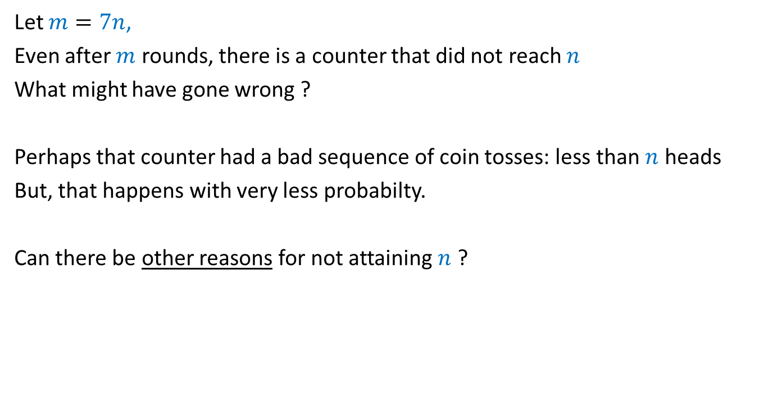
Let $m=7n$,
Even after $m$ rounds, there is a counter that did not reach $n$
What might have gone wrong ?
Perhaps that counter had a bad sequence of coin tosses: less than $n$ heads
But, that happens with very less probabilty.
Can there be other reasons for not attaining $n$ ?

Slide 17

Question
Can the bad coin tosses of a coin be the sole cause for the
experiment to fail (some counter does not reach $n$)
No

Slide 18










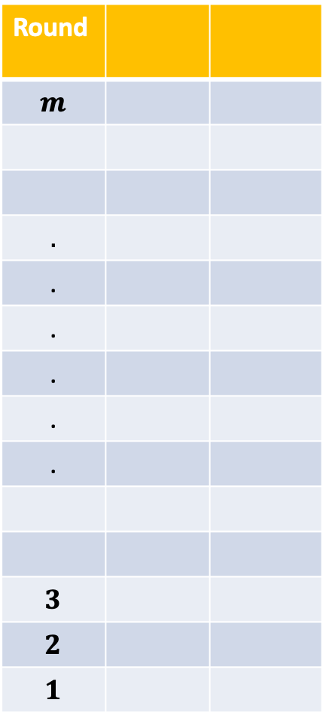



















Round
$$m$$
$$.$$
.
.
.
.
.
$$3$$
$$2$$
$$1$$
$$C_{1}$$
$$C_{2}$$
$$T$$
$$H$$
$$T$$
$$H$$
$$T$$
$$H$$
Hopefully, by now everyone is convinced about the “nontriviality” of the problem. ☺
$$⋮$$
$$⋮$$
$$1$$
$$1$$
$$2$$
$$0$$
$$T$$
$$H$$
$$C_{1}$$
$$C_{2}$$
$$T$$
$$H$$
$$H$$
$$T$$
$$H$$
$$T$$
$$H$$
$$T$$
$$⋮$$
$$⋮$$
$$H$$
$$T$$
$$H$$
$$T$$

Slide 19
Analysis using Delay Sequence
Key idea:
Pure scientific spirit to explain a phenomenon.

Slide 20
Warm up

Slide 21
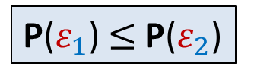

A question
Let $ε_{1}$ and $ε_{2}$ be any two events defined over a probability space.
Whenever $ε_{1}$ happens, $ε_{2}$ also happens.
$ε_{1}$ ➔ $ε_{2}$
Question: What is the relation between P($ε_{1}$) and P($ε_{2}$) ?
P($ε_{1}$) $≤$P($ε_{2}$)

Slide 22


















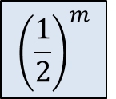











Round
Student
Outcome of coin toss
during the round
$$m$$
Shiv
$$T$$
$$m−1$$
Shiv
$$T$$
$$m−2$$
Shiv
$$H$$
$$m−3$$
$$⋮$$
$$T$$
$$m−4$$
$$H$$
$$m−5$$
$$H$$
$${\left(\frac{1}{2}\right)}^{m}$$
$$m−6$$
$$T$$
$$m−7$$
$$H$$
$$⋮$$
$$m−8$$
$$T$$
$$m−9$$
$$H$$
$$m−10$$
$$⋮$$
$$⋮$$
$$T$$
$$3$$
$$H$$
$$⋮$$
$$2$$
$$1$$
Shiv
$$⋮$$

Slide 23
Round
Student
Outcome of coin toss
during the round
$$m$$
Ritesh
Shiv
$$T$$
$$m−1$$
Jatin
$$T$$
Shiv
$$m−2$$
Saiteja
$$H$$
Shiv
$$m−3$$
Jatin
$$T$$
$$⋮$$
$$m−4$$
Waseem
$$H$$
$$m−5$$
Parul
$$H$$
Akarsh
$${\left(\frac{1}{2}\right)}^{m}$$
$$m−6$$
$$T$$
$$m−7$$
Yash
$$H$$
$$⋮$$
$$m−8$$
Paramansh
$$T$$
$$m−9$$
Rohin
$$H$$
$$m−10$$
Pranay
$$⋮$$
$$⋮$$
Nikhil
Prafull
$$T$$
$$3$$
Waseem
$$H$$
$$⋮$$
$$2$$
Rohin
Raghukul
$$⋮$$
$$1$$
Shiv

Slide 24
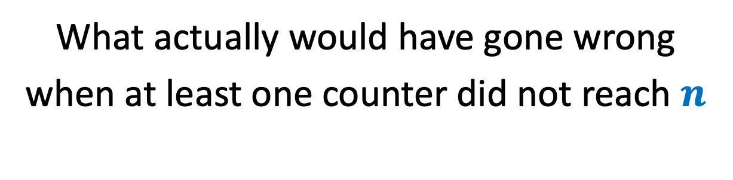
Let us start the investigation
What actually would have gone wrong
when at least one counter did not reach $n$

Slide 25















































Table formed to investigate the delay
Round
Counter
Counter value at the
end of the round
Outcome of coin toss
during the round
$$m$$
$$C_{i}$$
$$k$$
$$T$$
$$m−1$$
$$C_{i}$$
$$k$$
$$T$$
$$k$$
$$<n$$
$$m−2$$
$$C_{i}$$
$$k$$
$$H$$
$$m−3$$
$$C_{i}$$
$$T$$
$$i−2$$
$$i−1$$
$$i$$
$$k−1$$
$$m−4$$
$$C_{i}$$
$$k−1$$
$$H$$
$$m−5$$
$$C_{i}$$
$$k−1$$
$$H$$
$$C_{i−1}$$
$$k−2$$
$$m−6$$
$$C_{i−1}$$
$$k−3$$
$$T$$
$$m−7$$
$$C_{i−1}$$
$$k−3$$
$$H$$
$$m−8$$
$$C_{i−1}$$
$$k−3$$
$$C_{i−2}$$
$$k−4$$
$$T$$
$$m−9$$
$$C_{i−2}$$
$$k−4$$
$$H$$
$$m−10$$
?
?
$$⋮$$
$$⋮$$
$$⋮$$
$$⋮$$
$$C_{j}$$
$$ℓ$$
$$T$$
$$C_{j}$$
$$ℓ$$
$$H$$
$$C_{j±1}$$
$$C_{j}$$
$$ℓ−1$$
$$⋮$$
$$⋮$$
$$⋮$$
$$⋮$$

Slide 26
















Table formed to investigate the delay
Round
Counter
Counter value at the
end of the round
Outcome of coin toss
during the round
$$m$$
$$C_{i}$$
$$k$$
$$T$$
$$m−1$$
$$C_{i}$$
$$k$$
$$T$$
$$m−2$$
$$C_{i}$$
$$k$$
$$H$$
$$m−3$$
$$C_{i}$$
$$k−1$$
$$T$$
$$m−4$$
$$C_{i}$$
$$k−1$$
$$H$$
$$m−5$$
$$C_{i−1}$$
$$k−2$$
$$H$$
$$m−6$$
$$C_{i−1}$$
$$k−3$$
$$T$$
$$m−7$$
$$C_{i−1}$$
$$k−3$$
$$H$$
$$m−8$$
$$C_{i−2}$$
$$k−4$$
$$T$$
$$m−9$$
$$C_{i−2}$$
$$k−4$$
$$H$$
$$m−10$$
?
?
$$⋮$$
$$⋮$$
$$⋮$$
$$⋮$$
$$C_{j}$$
$$ℓ$$
$$T$$
$$C_{j}$$
$$ℓ$$
$$H$$
$$C_{j±1}$$
$$ℓ−1$$
$$⋮$$
$$⋮$$
$$⋮$$
$$⋮$$

Slide 27
Table formed to investigate the delay
Counter value at the
end of the round
Round
Counter
Outcome of coin toss
during the round
$$m$$
$$C_{i}$$
$$T$$
$$k$$
$$m−1$$
$$C_{i}$$
$$T$$
$$k$$
$$C_{i}$$
$$H$$
$$m−2$$
$$k$$
$$m−3$$
$$C_{i}$$
$$T$$
$$k−1$$
$$m−4$$
$$C_{i}$$
$$k−1$$
$$H$$
$$m−5$$
$$C_{i−1}$$
$$H$$
$$k−2$$
$$m−6$$
$$C_{i−1}$$
$$k−3$$
$$T$$
A delay sequence
$$m−7$$
$$C_{i−1}$$
$$H$$
$$k−3$$
$$m−8$$
$$C_{i−2}$$
$$T$$
$$k−4$$
$$m−9$$
$$C_{i−2}$$
$$k−4$$
$$H$$
$$m−10$$
?
?
$$⋮$$
$$⋮$$
$$⋮$$
$$⋮$$
$$C_{j}$$
$$T$$
$$ℓ$$
$$C_{j}$$
$$H$$
$$ℓ$$
$$C_{j±1}$$
$$ℓ−1$$
$$⋮$$
$$⋮$$
$$⋮$$
$$⋮$$

Slide 28
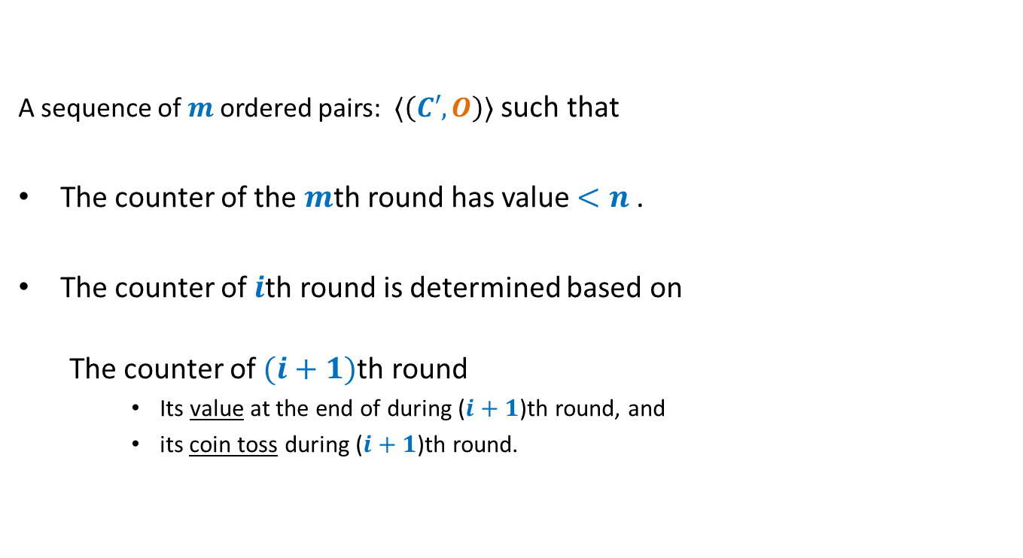
A delay sequence
A counter
A sequence of $m$ordered pairs: $⟨\left(C′,O\right)⟩$ such that
The counter of the $m$th round has value $<n$.
The counter of $i$th round is determined based on
The counter of $(i+1)$th round
Its value at the end of during ($i+1$)th round, and
its coin toss during ($i+1$)th round.
Outcome of its coin toss during a round

Slide 29

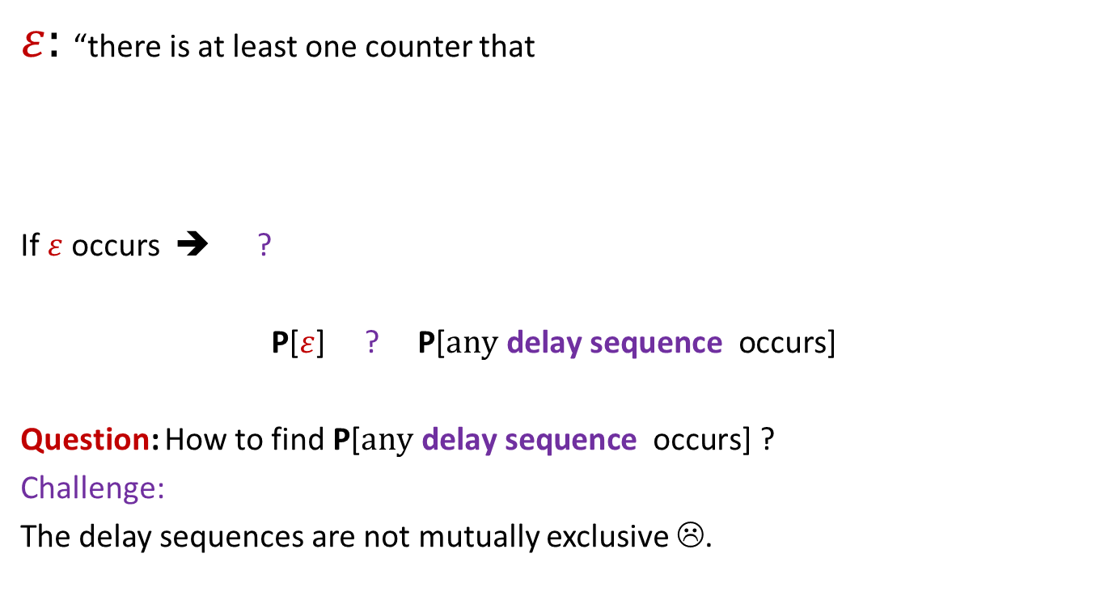

Why delay sequences ?
$ε:$ “there is at least one counter that
If $ε$ occurs ➔ ?
P[$ε$] ? P[$\text{a}\text{ny} \text{delay} \text{sequence} \text{occurs}$]
Question: How to find P[$\text{any} \text{delay} \text{sequence} \text{occurs}$] ?
Challenge:
The delay sequences are not mutually exclusive ☹.
did not attain value $n$ after $m$ rounds”
At least one delay sequence occurs
$$≤$$

Slide 30
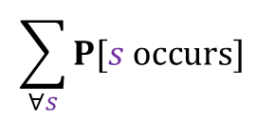

Why delay sequences ?
P[$\text{any} \text{delay} \text{sequence} \text{occurs}$] $≤$
➔
Question 1: How many delay sequences are there ?
Question 2: What can be the probability of a delay sequence ?
$$\sum_{∀s}{P[s occurs]}$$

Slide 31
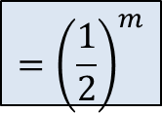

Table formed to investigate the delay
Counter value at the
end of the round
Round
Counter
Outcome of coin toss
during the round
$$m$$
$$C_{i}$$
$$T$$
$$k$$
$$m−1$$
$$C_{i}$$
$$T$$
$$k$$
Question 2:
How many delay sequences ?
$$C_{i}$$
$$H$$
$$m−2$$
$$k$$
$$m−3$$
$$C_{i}$$
$$T$$
$$k−1$$
$$m−4$$
$$C_{i}$$
$$k−1$$
$$H$$
Question 1:
What is the probability of this delay sequence ?
$$m−5$$
$$C_{i−1}$$
$$H$$
$$k−2$$
$$m−6$$
$$C_{i−1}$$
$$k−3$$
$$T$$
$$m−7$$
$$C_{i−1}$$
$$H$$
$$k−3$$
$$m−8$$
$$C_{i−2}$$
$$T$$
$$k−4$$
$$m−9$$
$$C_{i−2}$$
$$k−4$$
$$H$$
$${=\left(\frac{1}{2}\right)}^{m}$$
$$m−10$$
?
?
$$⋮$$
$$⋮$$
$$⋮$$
$$n$$
$$⋮$$
$$C_{j}$$
$$T$$
$$ℓ$$
$$C_{j}$$
$$H$$
$$ℓ$$
$$C_{j±1}$$
$$ℓ−1$$
$$⋮$$
$$⋮$$
$$⋮$$
$$⋮$$

Slide 32




Table formed to investigate the delay
Round
Counter
Counter value at the
end of the round
Outcome of coin toss
during the round
$$m$$
$$C_{i}$$
$$k$$
$$T$$
$$m−1$$
$$C_{i}$$
$$k$$
$$T$$
Question 2:
How many delay sequences ?
$$m−2$$
$$C_{i}$$
$$k$$
$$H$$
$$m−3$$
$$C_{i}$$
$$k−1$$
$$T$$
$$m−4$$
$$C_{i}$$
$$k−1$$
$$H$$
$$m−5$$
$$C_{i−1}$$
$$k−2$$
$$H$$
$$m−6$$
$$C_{i−1}$$
$$k−3$$
$$T$$
Exactly $k$
$$m−7$$
$$C_{i−1}$$
$$k−3$$
$$H$$
$$m−8$$
$$C_{i−2}$$
$$k−4$$
$$T$$
$$⋮$$
$$m−9$$
$$C_{i−2}$$
$$k−4$$
$$H$$
$$m−10$$
?
?
$$\left({m \atop k}\right)$$
$$⋮$$
$$⋮$$
$$⋮$$
$$⋮$$
$$n$$
$$n$$
$$C_{j}$$
$$ℓ$$
$$T$$
$$C_{j}$$
$$ℓ$$
$$H$$
$$C_{j±1}$$
$$ℓ−1$$
$$⋮$$
$$⋮$$
$$⋮$$
$$⋮$$

Slide 33

Table formed to investigate the delay
Counter value at the
end of the round
Round
Counter
Outcome of coin toss
during the round
$$m$$
$$C_{i}$$
$$T$$
$$k$$
$$m−1$$
$$C_{i}$$
$$T$$
$$k$$
Question 2:
How many delay sequences ?
$$C_{i}$$
$$H$$
$$m−2$$
$$k$$
$$m−3$$
$$C_{i}$$
$$T$$
$$k−1$$
$$m−4$$
$$C_{i}$$
$$k−1$$
$$H$$
$$m−5$$
$$C_{i−1}$$
$$H$$
$$k−2$$
$$m−6$$
$$C_{i−1}$$
$$k−3$$
$$T$$
$$m−7$$
$$C_{i−1}$$
$$H$$
$$k−3$$
$$m−8$$
$$C_{i−2}$$
$$T$$
$$k−4$$
$$m−9$$
$$C_{i−2}$$
$$k−4$$
$$H$$
$$m−10$$
?
?
$$\left({m \atop k}\right)$$
$${\left(3\right)}^{k}$$
$$⋮$$
$$⋮$$
$$⋮$$
$$n$$
$$n$$
$$⋮$$
$$C_{j}$$
$$T$$
$$ℓ$$
$$C_{j}$$
$$H$$
$$ℓ$$
$$C_{j±1}$$
$$ℓ−1$$
$$⋮$$
$$⋮$$
$$⋮$$
$$⋮$$

Slide 34
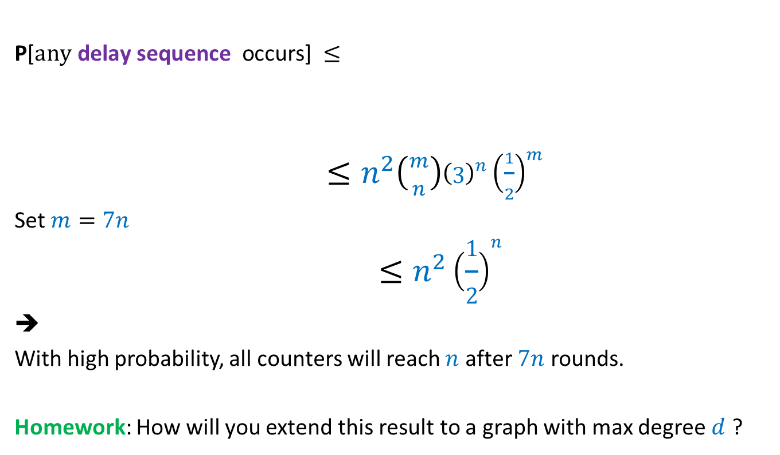


Why delay sequences ?
P[$\text{any} \text{delay} \text{sequence} \text{occurs}$] $≤$
$≤n^{2}\left({m \atop n}\right){\left(3\right)}^{n}{\left(\frac{1}{2}\right)}^{m}$
Set $m=7n$
$$≤n^{2}{\left(\frac{1}{2}\right)}^{n}$$
➔
With high probability, all counters will reach $n$ after $7n$ rounds.
Homework: How will you extend this result to a graph with max degree $d$ ?
$$\sum_{∀s}{P[s occurs]}$$
Since $\left({m \atop n}\right)≤{\left(\frac{em}{n}\right)}^{n}$
So $\left({m \atop n}\right)3^{n}<{\left(21e\right)}^{n}<{63}^{n}$

Slide 35
The Power of two choices
Another magical application

Slide 36
Balls into Bins
1 2 3 4 5 … $m−1$ $m$
Ball-bin Experiment: There are $m$ balls and $n$ bins.
Each ball selects its bin randomly uniformly and independent of other balls
and falls into it.
Applications:
Hashing
Load balancing in distributed environment
1 2 3 … $i$ … $n$

Slide 37
Balls into Bins
1 2 3 4 i … $m−1 m$
1 2 3 … $i$ … $n$

Slide 38
Balls into Bins
i … $m−1 m$
1 2 3 … $j$ … $n$

Slide 39
Balls into Bins
i … $m−1 m$
1 2 3 … $j$ … $n$

Slide 40

Balls into Bins
1 2 3 4 5 … $m−1 m$
Question : What is the load of most heavily loaded bin ?
The analysis is based on arguments similar to the “delay sequence” for the counter problem. But it is beyond the scope of this course.
1 2 3 … $i$ … $n$
O($log\log{n}$)

